Slide 1
Meeting Agenda
Digital Correspondence Circulation System
Desk Net (Intranet) includes:
Vehicle, meeting booking/availability
staff/expert contact address, Mailing list
schedule (mobi/demobi, meeting schedule, site visit schedule etc.)
3. PC and Software Inventory

Slide 2
1. Digital Correspondence Circulation System
In-Coming Letters
☐Circulation only : CLOSE
✅Action Required: OPEN
Send by:
DPWH, Design Team (Internal Memo), JV/AA etc.
Received by: Admin & Secretary Team
=> Register the circulation system
PMT (PM, DPM, Co-PM) instruct P.I.C
To: Team Leader of BRT
CC:
✅ RDT □ **T
□ ENVT ✅ **T
✅ COST □ **T
□ SVT ✅ **T
□ BIMT □ **T
Reply To: PMT
from: BRT
PMT (PM, DPM, Co-PM)
check their reply
1) make comments, or
2) If ok, reply to the DPWH etc. and change status of “CLOSE” in the system.
Subject: ****
Subject: ****
Instruction: *****
Reply: *****
Deadline: 21 June 2026
Attachment: ✅
Attachment: ✅

Slide 3
1. Digital Correspondence Circulation System
Out-Going Letters
Draft send by:
DPM, Co-PM, Design Team (Internal Memo)
etc.
PM check the draft and sign (E-signature)
Received by: Admin & Secretary Team
=> Register the circulation system
To: DPWH
CC:
✅ RDT □ **T
□ ENVT ✅ **T
✅ COST □ **T
□ SVT ✅ **T
□ BIMT □ **T
Subject: ****
Attachment: ✅

Slide 4
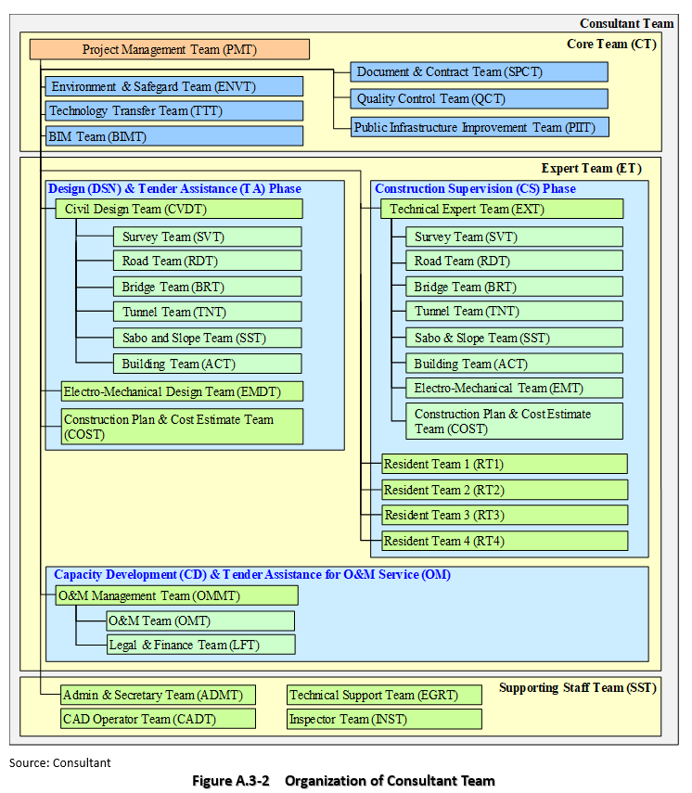
1. Digital Correspondence Circulation System

Slide 5
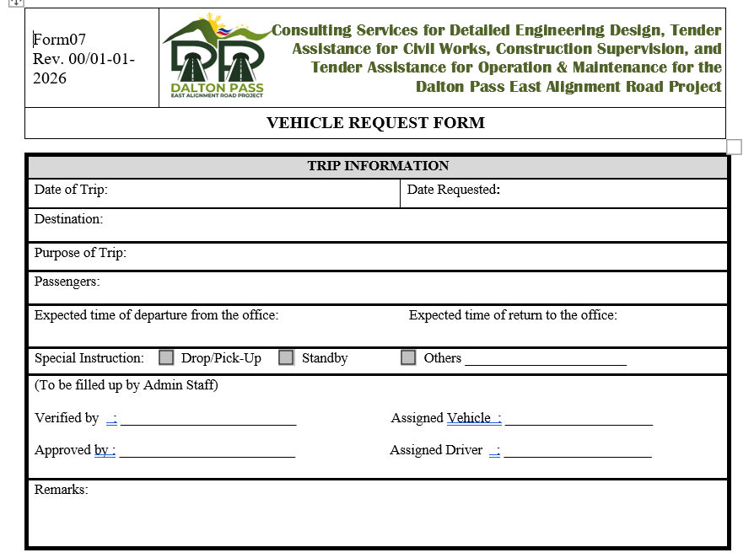
2. Desk Net (Intranet)
1) vehicle booking/availability
Users (expert/staff) submit Form 07-Vehicle Request
to Adm team.
Adm team inputs the schedule into the Desk Net.
See next slide.

Slide 6
2. Desk Net (Intranet)
1) vehicle booking/availability
Image
Week June 8 - 14
Next week
Vehicle | Driver | Mon | Tue | Wed | Thu | Fri | Sat | Sun
Toyota Fortuna (No.MNL-***) 7 seats | Eric 097-333-**** | 9:00-12:00
Nissan Terra (No. ) 7 seats |  |  | 9:00-12:00 Airport pick up
Nissan Van (No. ) 12 seats |  |  | 7:00 - | site | Site | site | Return 17:00

Slide 7
2. Desk Net (Intranet)
2) Meeting room booking/availability
Image
Week June 8 - 14
Next week
Vehicle | Mon | Tue | Wed | Thu | Fri | Sat | Sun
Room # (max 8 persons) | 9:00-12:00 (Adm team)
Room # (max 8 persons) |  | 9:00-12:00 (BRT)
Boardroom (max * persons) |  |  | 9:00-12:00 (bi-weekly meeting)

Slide 8
2. Desk Net (Intranet)
2) staff/expert contact address, Mailing list
Core Team (CT)
Project Management Team (PM) |  |  |  | Name | Email Address | Mobil phone No.
IE01A | Project Manager (DED) | Key | NK | Ichizuru Ishimoto | ishimoto-ic@n-koei.jp | 0917-179-2794
IE02A | Deputy Project Manager (DED) |  | NK | Shimpei Imada | imada-sh@n-koei.jp | 0917-179-3176
IE03A | Sr. Safety Engineer (DED) |  | OCG | Shinya Kameoka | kameoka-sn@ocglobal.jp
LE01A | Co-Project Manager (DED) | Key | KEI | Diego Espiña | diegoespina27@gmail.com
LE02A | Project Coordinator (DED) |  | PKII | Millard Cruz | mccruz@philkoei.com.ph
LE03A | Safety Engineer (DED) |  | PKII | Edito Bonicarlo
LE04A | Schedule Manager (DED) |  | PKII | John Mallillin
Environental Team (ENV)
IE04A | Sr. Environmental Specialist (Natural) (DED) |  | KEI | Taiji Tanoguchi | tanoguchi@katahira.com
IE05A | Sr. Environmental Specialist (Social) (DED) |  | NK | Hayato Kobayashi | kobayashi-hy@n-koei.jp
LE05A | Sr. Environmental Specialist (Natural) (DED) | Key | PKII | Lalaine Catulong
LE06A | Jr. Environmental Specialist (Natural) (DED) |  | KEI | Leonard Matias | Matias.lenard@yahoo.com.ph
LE07A | RAP Specialist (Social) (DED) |  | PKII | Kimberly Inso
LE08A | Property Appraiser Specialist (Social) (DED) |  | EDCOP | Jose Inventor Salvacion
LE09A | Indigenous Peoples Plan Specialist (DED) |  | KEI | Immanuel Lalo | dr.donatobumacas@yahoo.com
Document Team (SPC)
IE06A | Sr. Document/Contract Specialist (DED) |  | PKII | Danilo L. Lizardo
IE07A | Sr. Specification Writer (DED) |  | NK | Aye Myat Thu | aye.myat.thu@myanmar-koei.com
LE10A | Specification Writer 1, Tunnel Works (DED) |  | KEI | Evangelina Santos | vsantos416@gmail.com
LE11A | Specification Writer 2, Road&Bridge Works (DED) |  | PKII | Dindo Cajegas
LE12A | Specification Writer 3, Electrical & Mechanical Works (DED) |  | EDCOP | Ryan Ramilo

Slide 9
2. Desk Net (Intranet)
2) staff/expert contact address, Mailing list
No. | Mailing List | Purpose
1. | ml-7JV-members@dpearp.com.ph | JV (7 Japanese firms)
2. | ml-3Associate-members@dpearp.com.ph | Association (3 Local firms)
3. | ml-all-engineers-DED@dpearp.com.ph | All engineers in DED
4. | ml-PMT-DED@dpearp.com.ph | Project Management Team
5.

Slide 10
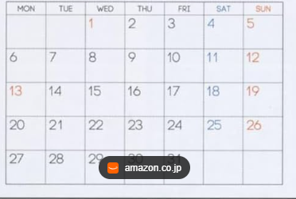
2. Desk Net (Intranet)
3) Schedule (mobi/demobi, meeting schedule, deliverable schedule, site visit schedule etc.)
2026 June
Next Month

Slide 11
3. PC and Software Inventory

